Slide 1
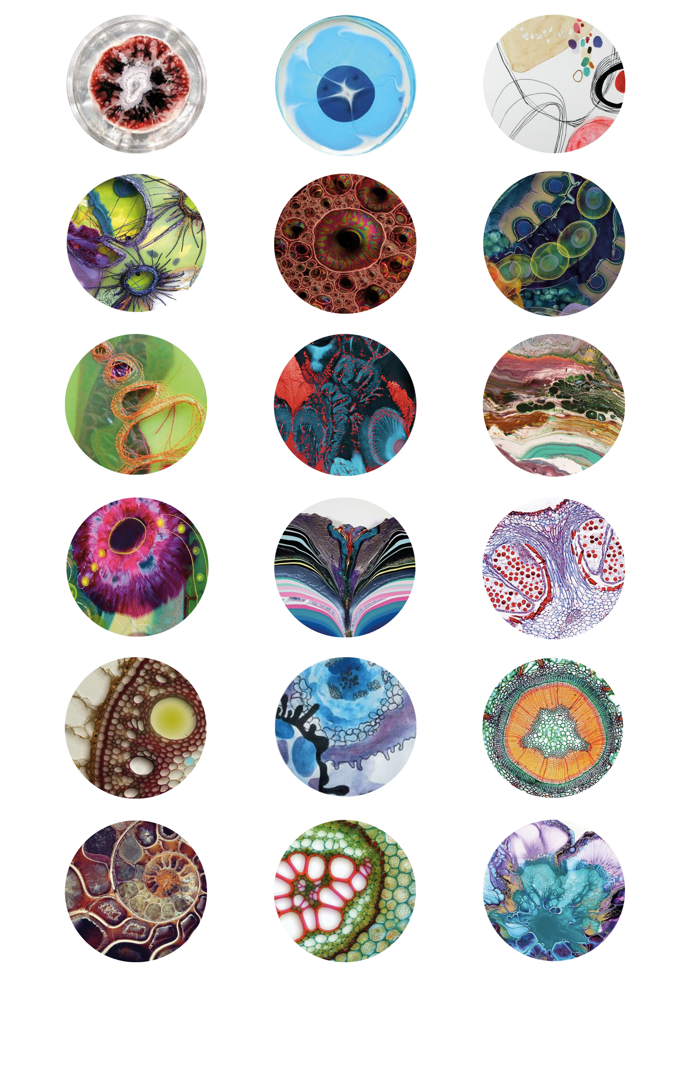
Welcome to our online experiment!

Slide 2
This is a multi-part study.
You need to complete different tasks.
Before you start, you will go through the instructions to prepare you for the main experiment.
You can take breaks during this study.
Please do NOT click the forward/backward button or close the browser until the experiment is finished.
Please do NOT refresh the page during whole experiment.

Slide 3
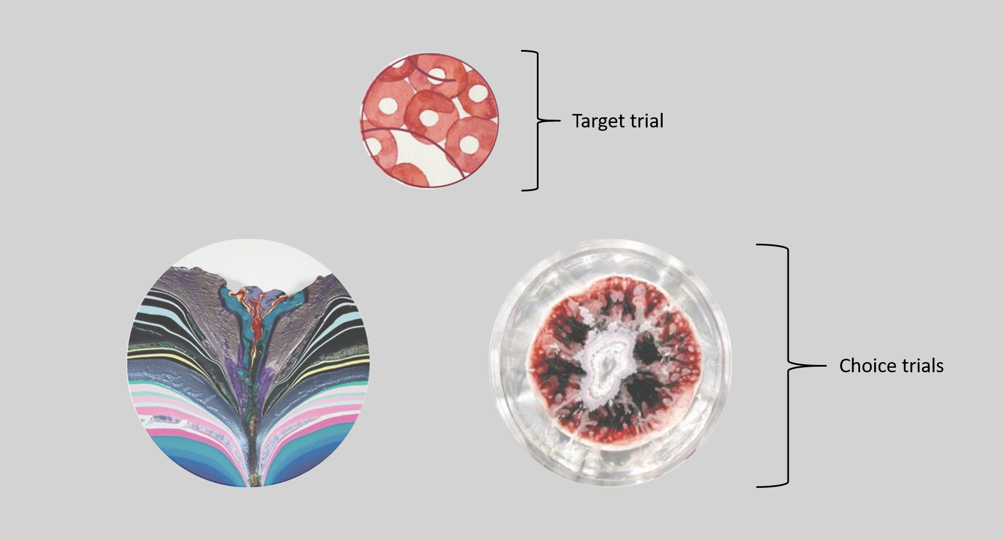
In the main part of the experiment, your goal is to learn over time which of two circle pictures is luckier.
When you choose the luckier picture, you will usually receive a 10 point bonus. When you choose the unlucky picture, you will usually receive 0 points.
At first you will just guess! Then through trial-and-error, you will learn which picture is luckier.

Slide 4
You will have a maximum of 3 seconds to make your choice for each trial.
Use the ‘f’ key to choose the LEFT picture.
Use the ‘j’ key to choose the RIGHT picture.
If you are too late, you will see a warning and get 0 points.
The pictures will randomly be shown on the left or right side. The location is not related to how lucky they are.

Slide 5
After your choice, the chosen picture will remain on the screen for 1 second before disappearing.
Then, after some delay, you will see feedback.
Lucky feedback:
Unlucky feedback:
+ 10 points!
0 points!

Slide 6
You will see a number of different pairs of circle pictures. Each pair will have one lucky and one unlucky picture; it's important to note that the lucky picture will remain the same. Pairs will be repeated so that you can learn
The more points you earn in the task, the more bonus you will be paid on top of your payment for your time – up to an additional 4.00 GBP! So please try your best!
Lucky feedback:
Unlucky feedback:
+ 10 points!
0 points!

Slide 7
For each pair of pictures, you will also see a “context” circle above.
This context circle does not relate to your choice, but it will *always* be shown with the same pair of pictures.

Slide 8
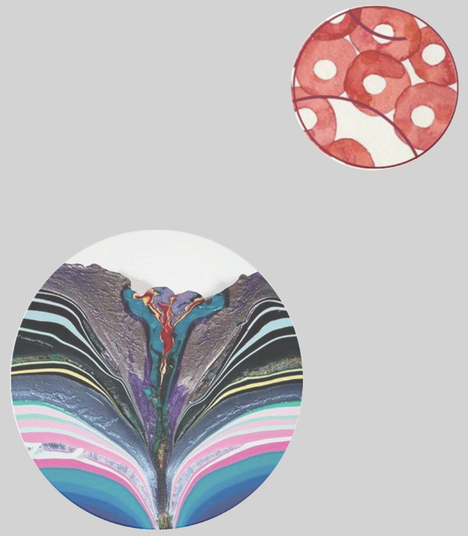
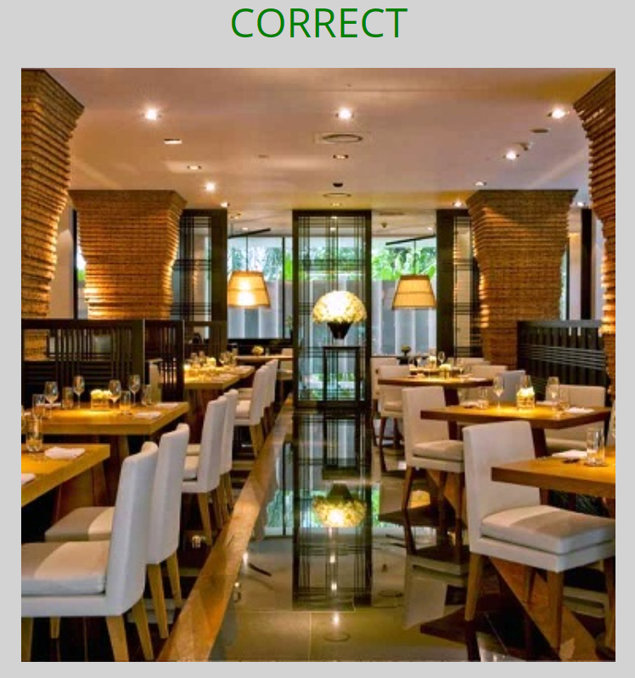
Review
[‘context’ picture]
+ 10 points!
Delay
Choose luckier picture with ‘f’ and ‘j’ keys
Chosen picture displayed
Variable duration
Feedback displayed

Slide 9
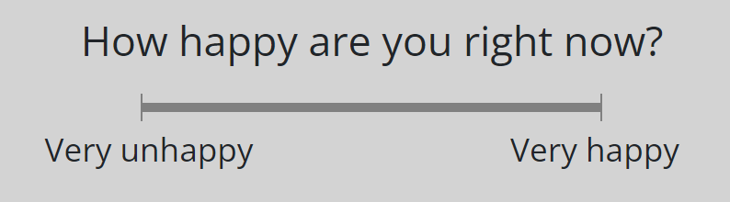
Mood Rating
Today, sometimes you will also see a screen asking you to rate your mood.
We collect happiness ratings because we are interested in changes in mood.
Note that the specific happiness ratings you provide have no influence at all on the rest of the experiment.
Just go with your initial feeling and click on the scale:

Slide 10
Before you start, you will go through a demo section to prepare you for the main experiment.
Demo section is starting soon.
You will respond by pressing the letters 'f' and 'j' only.
Now place your left index finger on the 'f' key and
your right index finger on the 'j' key.
Press 'f' or 'j' to continue

Slide 11
Thank you!
You have completed the demo part of the experiment.
Please be ready for the main part of the experiment.

Slide 12
Experiment is starting soon.
You will respond by pressing the letters 'f' and 'j' only.
Now place your left index finger on the 'f' key and
your right index finger on the 'j' key.
Press 'f' or 'j' to continue

Slide 13
Thank you!
You have completed the main part of the experiment.
Now, it's time for a 10-minute break. Feel free to exit full-screen mode and take some rest.

Slide 14
Break Time
You can feel free to take some rest.
Whenever you are ready to continue, please click the button below.

Slide 15
This is the end of the experiment!
Thank you for taking part! ☺
You can come back to PROLIFIC now by clicking the link below:

Slide 16
Next, you will engage in the first short memory test phase.
You will be presented with context circles (the ones from the middle of the screen). Your goal is to estimate the duration in seconds from the moment you made your choice selection until the feedback appeared on the screen.
The rating scale ranges from 0 to 12 seconds.
A rating of 0 sec represents the lowest time delay, indicating that the feedback appeared immediately after your choice, while a rating of 12 sec represents the highest time delay, indicating a significant delay between your choice and the feedback.
Please provide your best estimate! Guessing is OK!

Slide 17
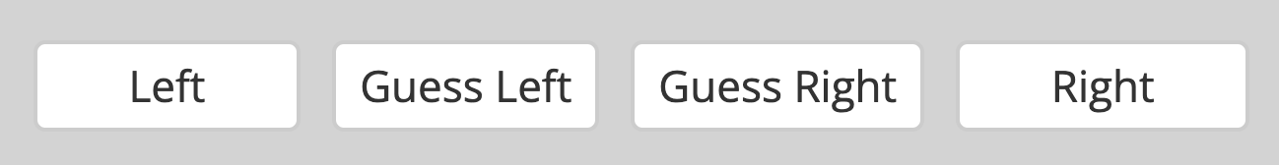
You have reached the last part!
This test is similar to the initial part: You will see two pictures, and your goal is to choose the one that you think is luckier (more likely to win points).
Use your knowledge from the previous part to select the picture that you think will win points more often. The pictures will be paired in new combinations.
Here, your response indicates your confidence:
The best strategy is to go with your initial feeling or "gut reaction". Guessing is ok!
Your choices will still win you points! However, you will not get feedback about the result. Instead, the computer will record how many points you earn. These points will be added toward your bonus payment.
Please do your best to focus and make good choices, so that you can increase your bonus.

Slide 18
Review
+ 10 points!
+ 10 points!
Delay
Choose luckier picture with ‘f’ and ‘j’ keys
Chosen picture displayed
Variable duration
Feedback displayed

Slide 19
Thank you!
You have completed the main part of the experiment.
Now, it's time for a 2-minute break. Feel free to exit full-screen mode and take some rest.

Slide 20
You have reached the last part!
The following task consists of two parts. First, you will see sentences on the screen, which you are supposed to read out loud. These sentences can make sense (e.g., "More and more women want to have a career.") or not (e.g., "I stopped by the gas station to refuel on apple juice."). Your first task is to judge the content of each sentence. You will do this by clicking a button to indicate whether it makes sense or not (yes or no button). After this decision, you will see a letter on the screen, which you are also supposed to read out loud. Your second task is to memorize this letter in order to recall it later on.
After two to six sentences (which you are supposed to judge) and letters (which you are supposed to memorize), you will see a page with six empty fields. Whenever this happens, please enter all the letters you still remember since the last round of empty fields. Often it's easier to recall the letters in the order in which they were presented, but this isn't really necessary. Please use only one field per letter. After you entered all the letters you still remember, you can start the next round by clicking the "Continue" button.

